Slide 1





Noida Institute of Engineering and Technology, Greater Noida
PREDICTIVE ANALYTICS
Unit: 4
Forecasting models
Mr. Sovers Singh Bisht
Assistant Professor
DS-DEPT
NIET
B-Tech 5TH Sem
ONLINE & Offline (Sec A, B)

Slide 2

Noida Institute of Engineering and Technology, Greater Noida
Mr. Sovers Singh Bisht
Dep. HOD (Data Science)
B.Tech, M.Tech
PH.D (P) in CSE ..
Area of Expertise: Data Science, Big Data Analytics
& Cloud Computing.

Slide 3

Evaluation Scheme
PROGRAM ELECTIVES BUCKET
DS
 | Data Analytics | Full Stack Development | Mobility Management | CRM-RPA
Program Elective 1 | Predictive Analytics | Python Web Development with Django | Mobile Application Development | CRM Fundamentals
Program Elective 2 | Web Technologies | Design Patterns | Development in Swift Fundamentals | CRM Administration
Program Elective 3 | Programming for Data Analytics | Advanced Java Programming | Development in Swift Explorations and Data Collections | CRM Development
Program Elective 4 | Social Media Analytics | Web Development using MEAN Stack | Augmented Reality and Virtual Reality | Robotics Process Automation (RPA)
Program Elective 5 | Natural language Processing | Web Development using MERN Stack | Game Programming | Robotics Process Automation (RPA) Implementation

Slide 4
Evaluation Scheme
DATA ANALYTICS (AI/AIML)
SUBJECTS | CREDITS | ELECTIVE | SEMESTER
Predictive Analytics | 3 | I | 5th
Web Technologies | 3 | II | 5th
Programming for Data Analytics | 3 | III | 6th
Social Media Analytics | 3 | IV | 6th
Natural language Processing | 3 | V | 7th

Slide 5

Evaluation Scheme
B.Tech. (Data Analytics-DS)
Elective- I
5th SEMESTER
PREDICTIVE ANALYTICS
L T P | Credits
3 – 0 – 0 | 3

Slide 6
Course Contents / Syllabus
B. TECH. THIRD YEAR (ELECTIVE-I)
Course code |  |  | L T P | Credits
Course title |  | PREDICTIVE ANALYTICS | 3 0 0 | 3
Course objective:
To be able to solve complex problems that require discovering hidden patterns in the data and a deep understanding of intricate relationships between a large number of interdependent variables tasked with collecting, analyzing, and interpreting large amounts of data.
Pre-requisites: Basic concepts of Machine learning Algorithms
Course Contents / Syllabus
UNIT-I | LINEAR REGRESSION |  |  | 8 HOURS
Introduction to Predictive Analytics, Regression basics: Relationship between attributes using Covariance and Correlation, Relationship, between multiple variables: Regression (Linear, Multivariate) in prediction, Residual Analysis Identifying significant features, feature reduction using AIC, multi-collinearity, Non-normality and Hetero scedasticity, Hypothesis testing of Regression Model, Confidence intervals of Slope, R-square and goodness of fit, Influential Observations – Leverage.
UNIT-II | MULTIPLE LINEAR REGRESSION |  |  | 8 HOURS
Polynomial Regression, Regularization methods, Lasso, Ridge and Elastic nets, Categorical Variables in Regression.
UNIT-III | NON-LINEAR REGRESSION |  |  | 8 HOURS
Logit function and interpretation, Types of error measures (ROCR), Logistic Regression in classification.

Slide 7
Course Contents / Syllabus
UNIT-IV |  | FORECASTING MODELS |  |  | 8 HOURS
Trend analysis, Cyclical and Seasonal analysis, smoothing, Moving averages, Box-Jenkins, Holt-winters, Autocorrelation, ARIMA, Examples: Applications of Time Series in financial markets.
UNIT-V |  | FEATURE ENGINEERING |  |  | 8 HOURS
Data Science Vs. Machine Learning, Exploratory Data Analysis, Feature Encoding, Imputation Feature Scaling, Determining correlation, Feature selection, Feature extraction.
Course outcome: After completion of this course students will be able to
CO 1 | Apply specific statistical and regression analysis methods applicable to predictive analytics to identify new trends and patterns, uncover relationships, create forecasts, predict likelihoods, and test predictive hypotheses. | Apply specific statistical and regression analysis methods applicable to predictive analytics to identify new trends and patterns, uncover relationships, create forecasts, predict likelihoods, and test predictive hypotheses. |  |  |  | K1, K2
CO 2 | Learn how to select the appropriate method for predictive analysis, and how to build effective predictive models. | Learn how to select the appropriate method for predictive analysis, and how to build effective predictive models. |  |  |  | K2
CO 3 | Learn how to evaluate the soundness, appropriateness and validity of their models and how to interpret and report on results for a management audience. | K3
CO 4 | Apply predictive analytics approaches on diverse business cases and scenarios. | K4
CO 5 | Understand the process of formulating business objectives, data selection/collection, preparation and process to successfully design, build, evaluate and implement predictive models for a various business application. | K5, K6

Slide 8
External Links as per Syllabus
NPTEL/ Youtube/ Faculty Video Link:
Unit 1 | Predictive Analytics Tutorial | Linear Regression in Python | Logistic Regression | Great Learning - YouTube Multiple Regression Analysis: Hypothesis Tests - YouTube Mod-06 Lec-28 Goodness of Fit - YouTube
Unit 2 | Multiple Linear Regression Model - YouTube Regularization In Machine Learning | Regularization Example | Machine Learning Tutorial |Simplilearn - YouTube Implementing Ridge, Lasso and Elastic Net in Python from Scratch (Mathematics Explained!) - YouTube
Unit 3 | Non Linear Regression | Data Science | Econometrics - YouTube Machine Learning Tutorial Python - 8: Logistic Regression (Binary Classification) - YouTube
Unit 4 | Time Series Talk : ARIMA Model - YouTube Holt winters Model, Easiest Times series Model. Additive multiplicative trend and seasonality - YouTube Time Series Analysis in Python | Time Series Forecasting | Data Science with Python | Edureka - YouTube
Unit 5 | Data Science vs Machine Learning – What’s The Difference? | Data Science Course | Edureka - YouTube Exploratory Data Analysis (EDA) Using Python | Python Data Analysis | Python Training | Edureka - YouTube Feature Selection In Machine Learning | Feature Selection Techniques With Examples | Simplilearn - YouTube

Slide 9
Branch wise Applications
Predictive analytics is a branch of advanced analytics that makes predictions about future outcomes using historical data combined with statistical modeling, data mining techniques and machine learning. Companies employ predictive analytics to find patterns in this data to identify risks and opportunities.
Predictive analytics are used to determine customer responses or purchases, as well as promote cross-sell opportunities. Predictive models help businesses attract, retain and grow their most profitable customers. Improving operations. Many companies use predictive models to forecast inventory and manage resources.
Predictive analytics uses statistics and modeling techniques to determine future performance.
Industries and disciplines, such as insurance and marketing, use predictive techniques to make important decisions.
Predictive models help make weather forecasts, develop video games, translate voice-to-text messages, customer service decisions, and develop investment portfolios.
People often confuse predictive analytics with machine learning even though the two are different disciplines.
Types of predictive models include decision trees, regression, and neural networks.

Slide 10
Course Objective
The objective of this course is -
To be able to solve complex problems that require discovering hidden patterns in the data and a deep understanding of intricate relationships between a large number of interdependent variables tasked with collecting, analyzing, and interpreting large amounts of data.

Slide 11
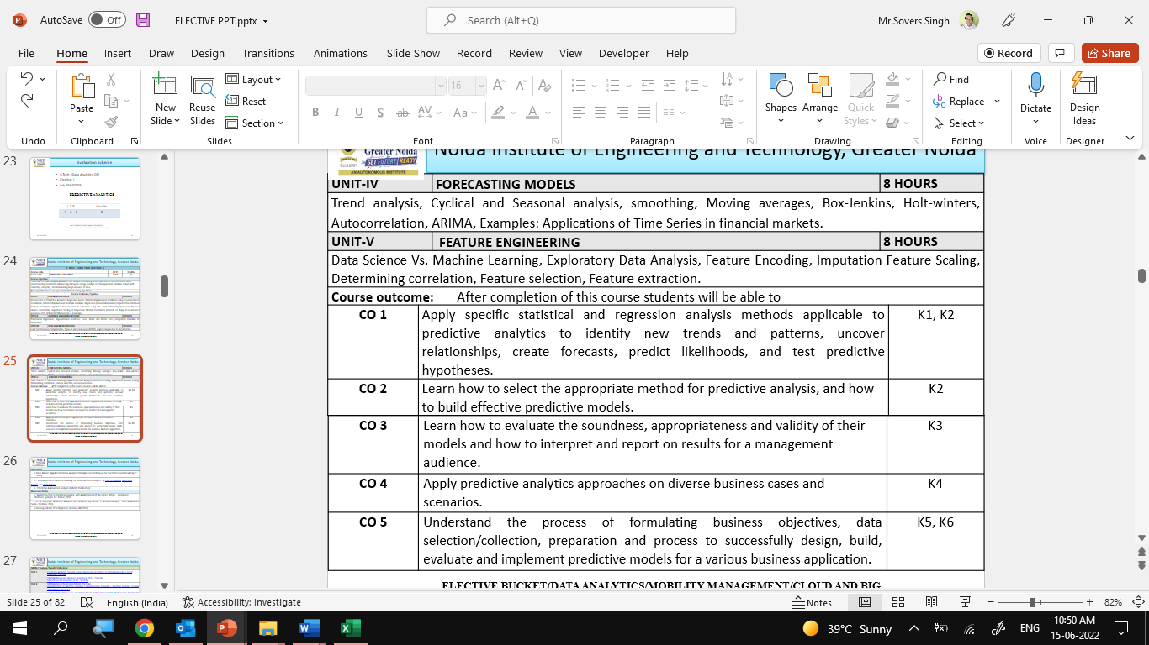

Course Outcomes

Slide 12
Program Outcomes
Engineering Graduates will be able to Understand:
1. Engineering knowledge
2. Problem analysis
3. Design/development of solutions
4. Conduct investigations of complex
5. Modern tool usage
6. The engineer and society
7. Environment and sustainability
8. Ethics
9. Individual and team work
10. Communication
11. Project management and finance
12. Life-long learning

Slide 13
CO-PO Mapping

Slide 14
Program Specific Outcomes (PSOs)
PSO’s
At the end of the program, the student will be able to-
PSO 1: Analyse, design and develop solutions by applying fundamental concepts of Data Science
PSO 2: Apply technical knowledge while using modern tools and technologies for solving complex problems.
PSO 3: Collaborate different fields of science and technology with right attitude, to work as an individual or as a team, demonstrating professional ethics for the well-being of society

Slide 15
COs and PSOs Mapping

Slide 16
Program Educational Objectives (PEOs)
PEO’s
The graduates of B.Tech Data Science program will-
PEO1: Solve real time complex problems and adapt to technological changes with the ability of lifelong learning.
PEO2: Work as data scientists ,entrepreneurs and bureaucrats for goodwill of the society and pursue higher education.
PEO3: Exhibit professional ethics and moral values with good leadership qualities and effective interpersonal skills

Slide 17
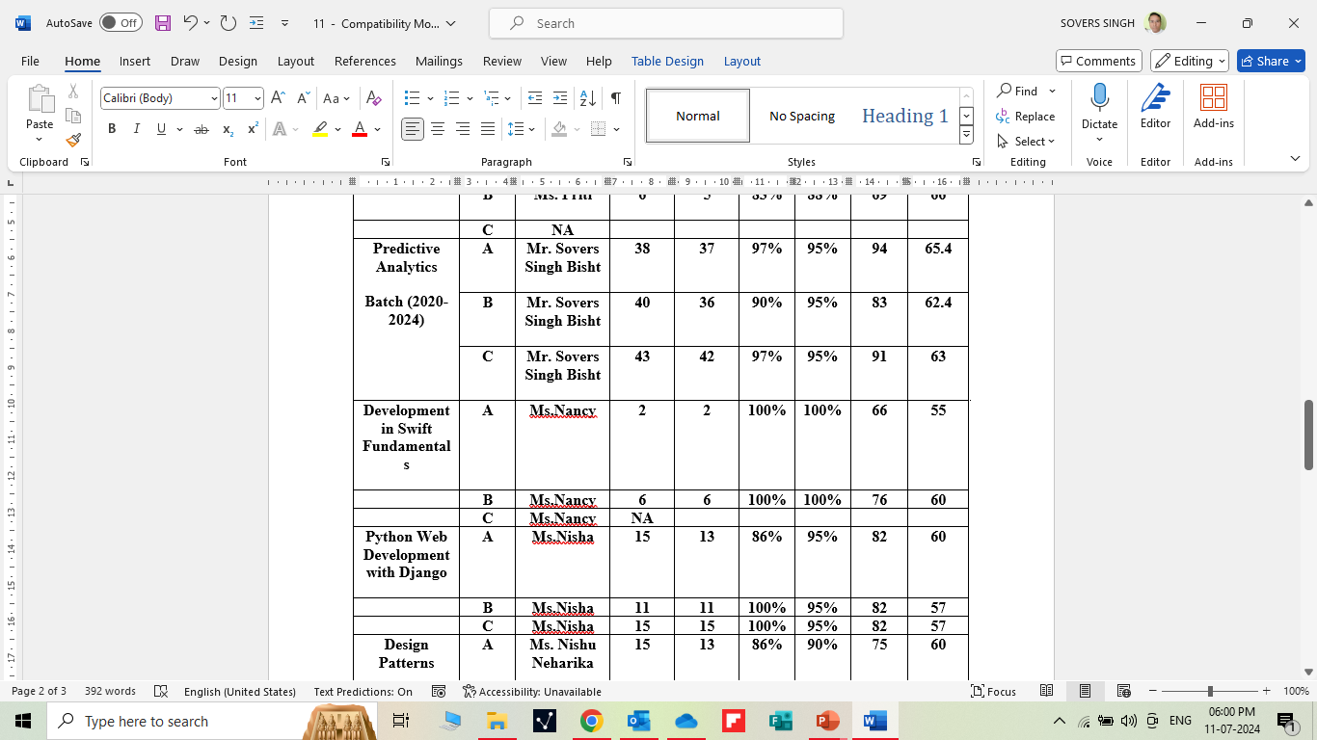
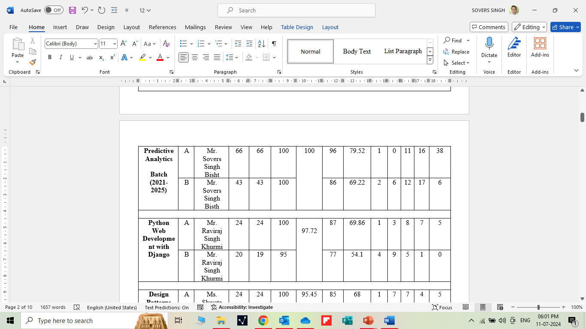
RESULT ANALYSIS

Slide 18
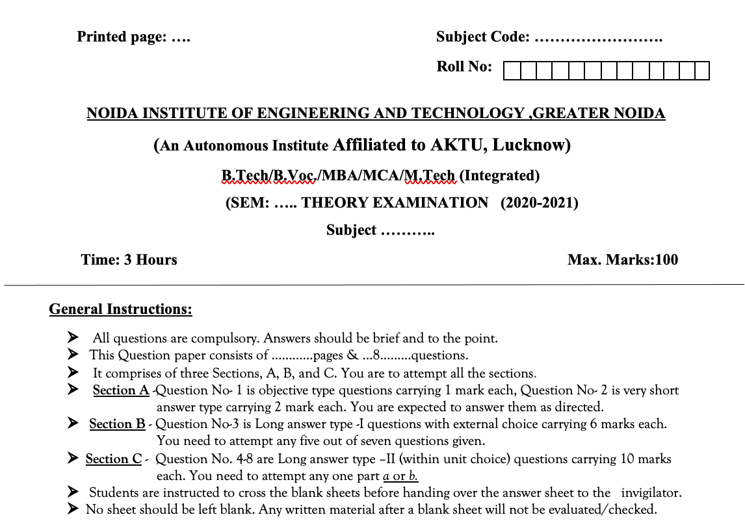
Question Paper Template

Slide 19
Question Paper Template
 |  | SECTION – A |  | CO
 | Attempt all parts- |  | [10×1=10]
 | 1-a. | Question- | (1)
 | 1-b. | Question- | (1)
 | 1-c. | Question- | (1)
 | 1-d. | Question- | (1)
 | 1-e. | Question- | (1)
 | 1-f. | Question- | (1)
 | 1-g. | Question- | (1)
 | 1-h. | Question- | (1)
 | 1-i. | Question- | (1)
 | 1-j. | Question- | (1)
2. | Attempt all parts- |  | [5×2=10] | CO
 | 2-a. | Question- | (2)
 | 2-b. | Question- | (2)
 | 2-c. | Question- | (2)
 | 2-d. | Question- | (2)
 | 2-e. | Question- | (2)
SECTION – B |  |  |  | CO
3. | Answer any five of the following- |  | [5×6=30]
 | 3-a. | Question- | (6)
 | 3-b. | Question- | (6)
 | 3-c. | Question- | (6)
 | 3-d. | Question- | (6)
 | 3-e. | Question- | (6)
 | 3-f. | Question- | (6)
 | 3-g. | Question- | (6)
SECTION – C |  |  |  | CO
4 | Answer any one of the following- |  | [5×10=50]
 | 4-a. | Question- | (10)
 | 4-b. | Question- | (10)
5. | Answer any one of the following-
 | 5-a. | Question- | (10)
 | 5-b. | Question- | (10)
6. | Answer any one of the following-
 | 6-a. | Question- | (10)
 | 6-b. | Question- | (10)
7. | Answer any one of the following-
 | 7-a. | Question- | (10)
 | 7-b. | Question- | (10)
8. | Answer any one of the following-
 | 8-a. | Question- | (10)
 | 8-b. | Question- | (10)

Slide 20
Prerequisite and Recap
Prerequisites:
Linux/ Windows operating system.
Knowledge of basic descriptive statistics and machine learning.
Java & R Studio.
MS Office 2019 and Above.
Programming Languages (Python)
Recap:
Discussion about Data Science Environments.

Slide 21
Brief Intro of Subject with video
Predictive analytics is a form of technology that makes predictions about certain unknowns in the future. It draws on a series of techniques to make these determinations, including artificial intelligence (AI), data mining, machine learning, modeling, and statistics.
For instance, data mining involves the analysis of large sets of data to detect patterns from it. Text analysis does the same, except for large blocks of text.
Predictive models are used for all kinds of applications, including:
Weather forecasts
Creating video games
Translating voice to text for mobile phone messaging
Customer service
Investment portfolio development
https://www.youtube.com/watch?v=4y6fUC56KPw
https://www.youtube.com/watch?v=JOArz7wggkQ

Slide 22
CONTENTS
Forecasting models:
Trend analysis
Cyclical and Seasonal analysis smoothing
Moving averages
Box-Jenkins
Holt-winters
Autocorrelation
ARIMA
Examples: Applications of Time Series in financial markets.

Slide 23
Unit Objective
The objective of the Unit 4 is :
1.To provide an overview of an exciting growing field of data science.
2. To inculcate the preliminary knowledge of handling data , discuss various statistical techniques for handling data.
3. Predictive analytics is a decision-making tool in a variety of industries.
4. Forecasting will help you to:
Monitor emerging market trends
Find new market opportunities
Create data-driven business strategies
Identify which products will be in high demand
Develop a consumer insights strategy based on business goals
Analyze the impact of trends in your brand and industry
Understand the social values that matter to consumers
Turn research findings into actionable insights
Benchmark against your competitors

Slide 24
Trend analysis
Objective:
In this topic we learn about Trend analysis that will allows you to predict what's going to happen, based on what's already happened. It provides businesses with information regarding marketing and sales performance, product development, spending, and more. Enabling businesses to make data-driven decisions with regard to future events.
Recap:
Revision of basic statistical approaches.

Slide 25
Trend analysis
Forecasting models
What is a forecasting model?
Forecasting models are one of the many tools businesses use to predict outcomes regarding sales, supply and demand, consumer behavior and more. These models are especially beneficial in the field of sales and marketing. There are several forecasting methods businesses use that provide varying degrees of information. From the simple to the complex, the appeal of using forecasting models comes from having a visual reference of expected outcomes.
Four common types of forecasting models
While there are numerous ways to forecast business outcomes, there are four main types of models or methods that companies use to predict actions in the future. You'll have a better understanding of how companies use these methods to enhance their business practices and improve the customer experience with the following examples of common forecasting models:

Slide 26
Trend analysis
•Time series model
•Econometric model
•Judgmental forecasting model
•The Delphi method
Time series model
This type of model uses historical data as the key to reliable forecasting. You'll be able to visualize patterns of data better when you know how the variables interact in terms of hours, weeks, months or years.
While there are several methods of completing a time series model, you can follow these general steps in a spreadsheet to estimate outcomes using information gleaned from recent analytical data:

Slide 27
Trend analysis
1. Have your time-based data available for use (time series and values series).
2. Input the compiled data involving time or duration in the first column.
3. Insert remaining values you want to forecast in the next column.
4. Select relevant data
5. Click the Data tab, then select Forecast Group, then choose Forecast Sheet.
6. Access the sheet, then select the line or bar graph option you want to use.
7. In the Forecast End box, determine your end date and hit Create.
Once you've set up your forecasting model, you will then move onto interpreting it to formulate your best estimation of the future.
Econometric model
Those employed in the field of economics often use an econometric model to forecast changes in supply and demand, as well as prices. These models incorporate complex data and knowledge throughout the process of creation. Like the name infers, this type of statistical model proves valuable when predicting future developments in the economy.
Here is the basic structure behind this type of model:

Slide 28
Trend analysis
1. Decide what your independent and dependent variables are. Which economic relation do you want to test? For example, you may ask "Does X have an effect on Y?"
2. Formulate a hypothesis to test this relationship. Consider other factors that may have an effect on "Y" and label them "Z," also known as the control variables.
3. Gather the data set encompassing "Y," "Z" and "X."
4. Plot this data to find any anomalies or outliers.
5. Determine whether the relationship between "Y" and "X" is linear, quadratic or something else.
6. Calculate the transformations using a mathematical method you understand.
7. Interpret the effect that "Y" has on "X." What is the significance of "X" about your hypothesis?
8. Add the "W" variables to this regression to further analyze your findings.

Slide 29
Trend analysis
Judgmental forecasting model
Various forecasting models of the judgmental kind utilize subjective and intuitive information to make predictions. For instance, there are times when there is no data available for reference. Launching a new product or facing unpredictable market conditions also creates situations in which judgmental forecasting models prove beneficial.
Here are some characteristics of judgmental models:
• Takes a subjective, opinionated approach
• Assumes specific variables
• Comes with limitations
• Accuracy improves with the addition of new information
This type of forecasting model is especially helpful in the field of research and development. Focus groups and expert panels can provide insight that no computerized model would have. For instance, when surveying a group of people about what they look for in a product, companies can better assess their direction when developing specific product features.

Slide 30
Trend analysis
The Delphi method
This method is commonly used to forecast trends based on the information given by a panel of experts. This series of steps is based on the Delphi method, which is about the Oracle of Delphi. It assumes that a group's answers are more useful and unbiased than answers provided by one individual. The total number of rounds involved may differ depending on the goal of the company or group's researchers.
These experts answer a series of questions in continuous rounds that ultimately lead to the "correct answer" a company is looking for. The quality of information improves with each round as the experts revise their previous assumptions following additional insight from other members in the panel. The method ends upon completion of a predetermined metric.

Slide 31
Trend analysis
Here is a list of steps you can take to make your own judgmental forecasting model:
1. Select a facilitator
Before choosing a facilitator who will manage the discussion, consider the neutrality of the individual and the person's experiences conducting research. The head of research and development may choose this role, for example.
2. Choose your experts
When businesses research a product that is not yet on the market, they rely on a panel of anonymous experts who can weigh in on the matter. Experts can be anyone with substantial experience in a given topic. For example, in the instance of developing a new swim product, a company may reach out to instructors or safety experts in the field. They may even approach professional athletes or loyal customers who use similar products.
3. Define the problem
Companies looking to solve a problem must first provide the details surrounding the problem, as well as the significant details that can help them make an informed decision. This ensures that everyone understands what is being asked of them. Businesses may want to create a new monofin with features that none of their competitors have tried before.
4. Round one questions
This first round of questions introduces the topic and starts the conversation. The experts will read the information, provide anonymous feedback and submit their information back to the facilitator.

Slide 32
Trend analysis
5. Round two questions
After the facilitator has reviewed the answers provided by the panel, edited content, filtered out irrelevant data and scanned through the content to find common themes, the facilitator then submits new information to the panel. Members of the panel have the chance to review the previous responses anonymously and based on the new information, can resubmit a response to another's statement. They again send their responses back to the facilitator.
6. Round three questions
For possibly the last time, the facilitator will review the new responses and again sort through the information presented before sending out the surveys to the panel. However, the process may continue until a general consensus is achieved, which can end in three or four iterations.
7. Take action
Once the researchers have received sufficient information, they can move ahead with any plans to implement their findings. This may be the start of new product development or the start of production on an item they were unsure about.

Slide 33
Trend analysis
1. Trend analysis
What Is Trend Analysis?
Trend analysis is a technique used in technical analysis that attempts to predict future stock price movements based on recently observed trend data. Trend analysis uses historical data, such as price movements and trade volume, to forecast the long-term direction of market sentiment.
KEY TAKEAWAYS
• Trend analysis tries to predict a trend, such as a bull market run, and then ride that trend until data suggests a trend reversal, such as a bull-to-bear market.
• Trend analysis is based on the idea that what has happened in the past gives traders an idea of what will happen in the future.
• Trend analysis focuses on three typical time horizons: short-; intermediate-; and long-term.

Slide 34
Trend analysis
Understanding Trend Analysis
Trend analysis tries to predict a trend, such as a bull market run, and ride that trend until data suggests a trend reversal, such as a bull-to-bear market. Trend analysis is helpful because moving with trends, and not against them, will lead to profit for an investor. It is based on the idea that what has happened in the past gives traders an idea of what will happen in the future. There are three main types of trends: short-, intermediate- and long-term.
A trend is a general direction the market is taking during a specified period of time. Trends can be both upward and downward, relating to bullish and bearish markets, respectively. While there is no specified minimum amount of time required for a direction to be considered a trend, the longer the direction is maintained, the more notable the trend.
Trend analysis is the process of looking at current trends in order to predict future ones and is considered a form of comparative analysis. This can include attempting to determine whether a current market trend, such as gains in a particular market sector, is likely to continue, as well as whether a trend in one market area could result in a trend in another. Though a trend analysis may involve a large amount of data, there is no guarantee that the results will be correct.

Slide 35
Trend analysis
In order to begin analyzing applicable data, it is necessary to first determine which market segment will be analyzed. For instance, you could focus on a particular industry, such as the automotive or pharmaceuticals sector, as well as a particular type of investment, such as the bond market.
Once the sector has been selected, it is possible to examine its general performance. This can include how the sector was affected by internal and external forces. For example, changes in a similar industry or the creation of a new governmental regulation would qualify as forces impacting the market. Analysts then take this data and attempt to predict the direction the market will take moving forward.
Critics of trend analysis, and technical trading in general, argue that markets are efficient, and already price in all available information. That means that history does not necessarily need to repeat itself and that the past does not predict the future. Adherents of fundamental analysis, for example, analyze the financial condition of companies using financial statements and economic models to predict future prices. For these types of investors, day-to-day stock movements follow a random walk that cannot be interpreted as patterns or trends. Critics of trend analysis, and technical trading in general, argue that markets are efficient, and already price in all available information. That means that history does not necessarily need to repeat itself and that the past does not predict the future. Adherents of fundamental analysis, for example, analyze the financial condition of companies using financial statements and economic models to predict future prices. For these types of investors, day-to-day stock movements follow a random walk that cannot be interpreted as patterns or trends.

Slide 36
Trend analysis
Trend Trading Strategies
Trend traders attempt to isolate and extract profit from trends. There are many different trend trading strategies using a variety of technical indicators:
• Moving Averages: These strategies involve entering into long positions when a short-term moving average crosses above a long-term moving average, and entering short positions when a short-term moving average crosses below a long-term moving average.
• Momentum Indicators: These strategies involve entering into long positions when a security is trending with strong momentum and exiting long positions when a security loses momentum. Often, the relative strength index (RSI) is used in these strategies.
• Trendlines & Chart Patterns: These strategies involve entering long positions when a security is trending higher and placing a stop-loss below key trendline support levels. If the stock starts to reverse, the position is exited for a profit.

Slide 37
Trend analysis
Trend following is a trading system based on using trend analysis and following the recommendation produced to determine which investments to make. Often, the analysis is conducted via computer analysis and modeling of relevant data and is tied to market momentum.
Indicators can simplify price information, as well as provide trend trade signals or warn of reversals. They may be used on all time frames, and have variables that can be adjusted to suit each trader's specific preferences.
Usually, it is advisable to combine indicator strategies or come up with your own guidelines, so entry and exit criteria are clearly established for trades. Each indicator can be used in more ways than outlined. If you like an indicator, research it further, and most importantly, test it out before using it to make live trades.

Slide 38
Trend analysis
What Is a Trend?
A trend is the overall direction of a market during a specified period of time. Trends can be both upward and downward, relating to bullish and bearish markets, respectively. While there is no specified minimum amount of time required for a direction to be considered a trend, the longer the direction is maintained, the more notable the trend. Trends are identified by drawing lines, known as trendlines, that connect price action making higher highs and higher lows for an uptrend, or lower lows and lower highs for a downtrend.
What Are Examples of Trend Trading Strategies?
Trend trading strategies attempt to isolate and extract profit from trends by combining a variety of technical indicators along with the financial instrument's price action. Typically, these include moving averages, momentum indicators, and trendlines, and chart patterns.
Moving averages strategies involve entering into long, or short, positions when the short-term moving average crosses above, or below, a long-term moving average. Momentum indicator strategies involve entering into positions when a security is exhibiting strong momentum and exiting when that wanes. Trendlines and chart pattern strategies involve entering long, or short, positions when a security is trending higher, or lower, and placing a stop-loss below, or above, key trendline support levels to exit the trade.

Slide 39
Trend analysis
What Are Some Criticisms of Trend Analysis?
Critics of trend analysis, and technical trading in general, argue that markets are efficient, and already price in all available information. That means that history does not necessarily need to repeat itself and that the past does not predict the future. Adherents of fundamental analysis, for example, analyze the financial condition of companies using financial statements and economic models to predict future prices. For these types of investors, day-to-day stock movements follow a random walk that cannot be interpreted as patterns or trends.

Slide 40
Cyclical and Seasonal analysis smoothing
Objective:
In this topic we learn about Structured data that is clearly defined and searchable types of data, while unstructured data is usually stored in its native format. Structured data is quantitative, while unstructured data is qualitative. Structured data is often stored in data warehouses, while unstructured data is stored in data lakes
Recap:
Revision of basic statistical approaches.

Slide 41
Cyclical and Seasonal analysis smoothing
2. Cyclical and Seasonal analysis
These terms get confused all the time (e.g., this question on CrossValidated.com), and so I thought it might be helpful to try to summarize the distinction and some of the associated models.
Definitions
A seasonal pattern exists when a series is influenced by seasonal factors (e.g., the quarter of the year, the month, or day of the week). Seasonality is always of a fixed and known period. Hence, seasonal time series are sometimes called periodic time series.
A cyclic pattern exists when data exhibit rises and falls that are not of fixed period. The duration of these fluctuations is usually of at least 2 years. Think of business cycles which usually last several years, but where the length of the current cycle is unknown beforehand.

Slide 42
Cyclical and Seasonal analysis smoothing
Many people confuse cyclic behaviour with seasonal behaviour, but they are really quite different. If the fluctuations are not of fixed period then they are cyclic; if the period is unchanging and associated with some aspect of the calendar, then the pattern is seasonal. In general, the average length of cycles is longer than the length of a seasonal pattern, and the magnitude of cycles tends to be more variable than the magnitude of seasonal patterns.

Slide 43
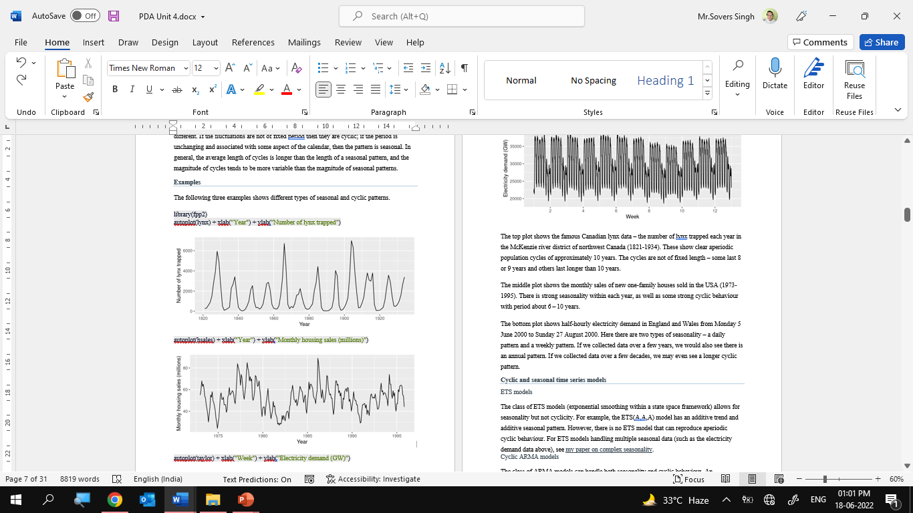
Cyclical and Seasonal analysis smoothing

Slide 44
Cyclical and Seasonal analysis smoothing
parameters in order to obtain cyclicity. For an AR(2), where yt=c+ϕ1yt−1+ϕ2yt−2+εt and εt is white noise, cyclic behaviour is observed if ϕ12+4ϕ2<0. In that case, the average period of the cycles is2πarc cos(−ϕ1(1−ϕ2)/(4ϕ2)).For example, the lynx data can be modelled (although not very well) withyt=1545+1.147yt−1−0.600yt−2+εt,giving an average cyclic period of 8.97. See Jiru (2008) for derivations and further results along these lines.
Seasonal ARMA models
A seasonal ARMA model requires additional seasonal terms. For example, a seasonal ARMA(1,0)(1,0)4 for quarterly data is written as(1−ϕ1B)(1−Φ1B4)yt=εtwhere B is the backshift operator. The quarterly seasonality is explicitly handled with the term involving B4.
It is possibly to have both cyclic and seasonal behaviour in an ARMA model, but long-period cyclicity is not handled very well in the ARMA framework. Alternative (nonlinear) models are usually better.
Periodic ARMA models
There is also a class of periodic ARMA models where the parameters take different values in different seasons. For example, a periodic AR(2) for quarterly data could be written asyt=ϕ1,syt−1+ϕ2,syt−2+εtwhere s=t mod 4 denotes the four seasons. A model of this kind could handle data with both cyclic and seasonal patterns more easily than a seasonal ARMA model.

Slide 45
Cyclical and Seasonal analysis smoothing
Smoothing Time Series
Smoothing is usually done to help us better see patterns, trends for example, in time series. Generally smooth out the irregular roughness to see a clearer signal. For seasonal data, we might smooth out the seasonality so that we can identify the trend. Smoothing doesn’t provide us with a model, but it can be a good first step in describing various components of the series.
The term filter is sometimes used to describe a smoothing procedure. For instance, if the smoothed value for a particular time is calculated as a linear combination of observations for surrounding times, it might be said that we’ve applied a linear filter to the data (not the same as saying the result is a straight line, by the way).

Slide 46
Moving averages
Objective:
In this topic we learn about moving average is a calculation used to analyze data points by creating a series of averages of different subsets of the full data set. In finance, a moving average (MA) is a stock indicator that is commonly used in technical analysis.
Recap:
Revision of basic statistical approaches.

Slide 47
Moving averages
4. Moving averages
What Is a Moving Average (MA)?
In statistics, a moving average is a calculation used to analyze data points by creating a series of averages of different subsets of the full data set. In finance, a moving average (MA) is a stock indicator that is commonly used in technical analysis. The reason for calculating the moving average of a stock is to help smooth out the price data by creating a constantly updated average price.
By calculating the moving average, the impacts of random, short-term fluctuations on the price of a stock over a specified time frame are mitigated.

Slide 48
Moving averages
KEY TAKEAWAYS
• A moving average (MA) is a stock indicator that is commonly used in technical analysis.
• The reason for calculating the moving average of a stock is to help smooth out the price data over a specified period of time by creating a constantly updated average price.
• A simple moving average (SMA) is a calculation that takes the arithmetic mean of a given set of prices over the specific number of days in the past; for example, over the previous 15, 30, 100, or 200 days.
• Exponential moving averages (EMA) is a weighted average that gives greater importance to the price of a stock in more recent days, making it an indicator that is more responsive to new information.

Slide 49
Moving averages
Moving Average
Understanding a Moving Average (MA)
Moving average is a simple, technical analysis tool. Moving averages are usually calculated to identify the trend direction of a stock or to determine its support and resistance levels. It is a trend-following—or lagging—indicator because it is based on past prices.
The longer the time period for the moving average, the greater the lag. So, a 200-day moving average will have a much greater degree of lag than a 20-day MA because it contains prices for the past 200 days. The 50-day and 200-day moving average figures for stocks are widely followed by investors and traders and are considered to be important trading signals.
Moving averages are a totally customizable indicator, which means that an investor can freely choose whatever time frame they want when calculating an average. The most common time periods used in moving averages are 15, 20, 30, 50, 100, and 200 days. The shorter the time span used to create the average, the more sensitive it will be to price changes. The longer the time span, the less sensitive the average will be.
Investors may choose different time periods of varying lengths to calculate moving averages based on their trading objectives. Shorter moving averages are typically used for short-term trading, while longer-term moving averages are more suited for long-term investors.

Slide 50
Moving averages
There is no correct time frame to use when setting up your moving averages. The best way to figure out which one works best for you is to experiment with a number of different time periods until you find one that fits your strategy.
Predicting trends in the stock market is no simple process. While it is impossible to predict the future movement of a specific stock, using technical analysis and research can help you make better predictions.
A rising moving average indicates that the security is in an uptrend, while a declining moving average indicates that it is in a downtrend. Similarly, upward momentum is confirmed with a bullish crossover, which occurs when a short-term moving average crosses above a longer-term moving average. Conversely, downward momentum is confirmed with a bearish crossover, which occurs when a short-term moving average crosses below a longer-term moving average.1

Slide 51
Moving averages
Exponential Moving Average (EMA)
The exponential moving average is a type of moving average that gives more weight to recent prices in an attempt to make it more responsive to new information. To calculate an EMA, you must first compute the simple moving average (SMA) over a particular time period. Next, you must calculate the multiplier for weighting the EMA (referred to as the "smoothing factor"), which typically follows the formula: [2/(selected time period + 1)]. So, for a 20-day moving average, the multiplier would be [2/(20+1)]= 0.0952. Then you use the smoothing factor combined with the previous EMA to arrive at the current value. The EMA thus gives a higher weighting to recent prices, while the SMA assigns an equal weighting to all values.
\begin{aligned} &EMA_t = \left [ V_t \times \left ( \frac{ s }{ 1 + d } \right ) \right ] + EMA_y \times \left [ 1 - \left ( \frac { s }{ 1 + d} \right ) \right ] \\ &\textbf{where:}\\ &EMA_t = \text{EMA today} \\ &V_t = \text{Value today} \\ &EMA_y = \text{EMA yesterday} \\ &s = \text{Smoothing} \\ &d = \text{Number of days} \\ \end{aligned}EMAt=[Vt×(1+ds)]+EMAy×[1−(1+ds)]where:EMAt=EMA todayVt=Value todayEMAy=EMA yesterdays=Smoothingd=Number of days
Simple Moving Average (SMA) vs. Exponential Moving Average (EMA)

Slide 52
Moving averages
The calculation for EMA puts more emphasis on the recent data points. Because of this, EMA is considered a weighted average calculation.
In the figure below, the number of time periods used in each average is identical–15–but the EMA responds more quickly to the changing prices than the SMA. You can also observe in the figure that the EMA has a higher value when the price is rising than the SMA (and it falls faster than the SMA when the price is declining). This responsiveness to price changes is the main reason why some traders prefer to use the EMA over the SMA.
Example of a Moving Average
The moving average is calculated differently depending on the type: SMA or EMA. Below, we look at a simple moving average (SMA) of a security with the following closing prices over 15 days:
• Week 1 (5 days): 20, 22, 24, 25, 23
• Week 2 (5 days): 26, 28, 26, 29, 27
• Week 3 (5 days): 28, 30, 27, 29, 28
A 10-day moving average would average out the closing prices for the first 10 days as the first data point. The next data point would drop the earliest price, add the price on day 11 and take the average.

Slide 53
Box-Jenkins
Objective:
In this topic we learn about the Box-Jenkins Model which can analyze several different types of time series data for forecasting purposes. Its methodology uses differences between data points to determine outcomes. The methodology allows the model to identify trends using auto regresssion, moving averages, and seasonal differencing to generate forecasts.
Recap:
Revision of basic statistical approaches.

Slide 54
Box-Jenkins
The Box-Jenkins Method
Introduction
Box - Jenkins Analysis refers to a systematic method of identifying, fitting, checking, and using integrated autoregressive, moving average (ARIMA) time series models. The method is appropriate for time series of medium to long length (at least 50 observations).
In this chapter we will present an overview of the Box-Jenkins method, concentrating on the how-to parts rather than on the theory. Most of what is presented here is summarized from the landmark book on time series analysis written by George Box and Gwilym Jenkins (1976).
A time series is a set of values observed sequentially through time. The series may be denoted by X1 , X 2 , ☹, Xt , where t refers to the time period and X refers to the value. If the X’s are exactly determined by a mathematical
formula, the series is said to be deterministic. If future values can be described only by their probability distribution, the series is said to be a statistical or stochastic process.
A special class of stochastic processes is a stationary stochastic process. A statistical process is stationary if the probability distribution is the same for all starting values of t. This implies that the mean and variance are constant for all values of t. A series that exhibits a simple trend is not stationary because the values of the series depend on
t. A stationary stochastic process is completely defined by its mean, variance, and autocorrelation function. One of the steps in the Box - Jenkins method is to transform a non-stationary series into a stationary one.

Slide 55
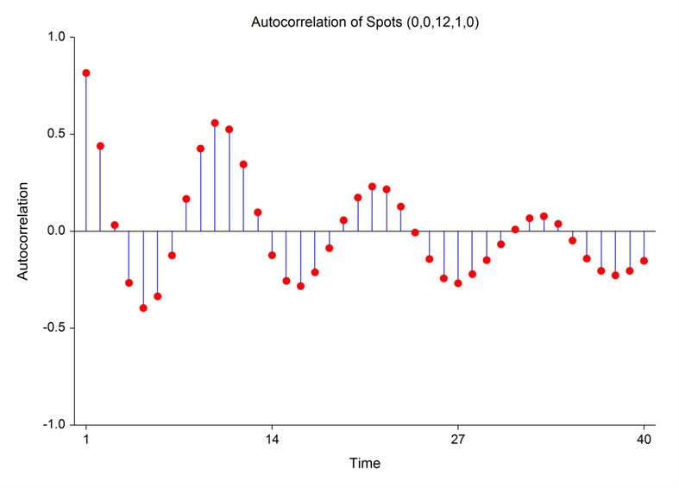
Box-Jenkins
Autocorrelation Function
The stationary assumption allows us to make simple statements about the correlation between two successive values, Xt and Xt  k . This correlation is called the autocorrelation of lag k of the series. The autocorrelation function displays the autocorrelation on the vertical axis for successive values of k on the horizontal axis. The following figure shows the autocorrelation function of the sunspot data.
Since a stationary series is completely specified by its mean, variance, and autocorrelation function, one of the major (and most subjective) tasks in Box-Jenkins analysis is to identify an appropriate model from the sample autocorrelation function. Although the sample autocorrelations contains random fluctuations, for moderate sample sizes they are fairly accurate in signaling the order of the ARIMA model.

Slide 56
Holt-winters
Objective:
In this topic we learn about the Holt-Winters method uses exponential smoothing to encode lots of values from the past and use them to predict “typical” values for the present and future. Exponential smoothing refers to the use of an exponentially weighted moving average (EWMA) to “smooth” a time series.
Recap:
Revision of basic statistical approaches.

Slide 57
Holt-winters
Holt-Winters’ seasonal method
Holt (1957) and Winters (1960) extended Holt’s method to capture seasonality. The Holt-Winters seasonal method comprises the forecast equation and three smoothing equations — one for the level ℓtℓt, one for the trend btbt, and one for the seasonal component stst, with corresponding smoothing parameters αα, β∗β∗ and γγ. We use mm to denote the frequency of the seasonality, i.e., the number of seasons in a year. For example, for quarterly data m=4m=4, and for monthly data m=12m=12.
There are two variations to this method that differ in the nature of the seasonal component. The additive method is preferred when the seasonal variations are roughly constant through the series, while the multiplicative method is preferred when the seasonal variations are changing proportional to the level of the series. With the additive method, the seasonal component is expressed in absolute terms in the scale of the observed series, and in the level equation the series is seasonally adjusted by subtracting the seasonal component. Within each year, the seasonal component will add up to approximately zero. With the multiplicative method, the seasonal component is expressed in relative terms (percentages), and the series is seasonally adjusted by dividing through by the seasonal component. Within each year, the seasonal component will sum up to approximately mm.

Slide 58
Holt-winters
What Is the Holt-Winters Method?
Holt-Winters is a model of time series behavior. Forecasting always requires a model, and Holt-Winters is a way to model three aspects of the time series: a typical value (average), a slope (trend) over time, and a cyclical repeating pattern (seasonality).
Time series anomaly detection is a complicated problem with plenty of practical methods. It’s easy to get lost in all of the topics it encompasses. Learning them is certainly an issue, but implementing them is often more complicated. A key element of anomaly detection is forecasting—taking what you know about a time series, either based on a model or its history, and making decisions about values that arrive later.
You know how to do this already. Imagine someone asked you to forecast the prices for a certain stock, or the local temperature over the next few days. You could draw out your prediction, and chances are it’s a pretty good one. Your brain works amazingly well for problems like this, and our challenge is to try to get computers to do the same.
If you take an introductory course on time series, you’ll learn how to forecast by fitting a model to some sample data, and then using the model to predict future values. In practice, especially when monitoring systems, this approach doesn’t work well, if at all! Real systems rarely fit mathematical models. There’s an alternative. You can do something a lot simpler with exponential smoothing.

Slide 59
Holt-winters
Holt-Winters Triple Exponential Smoothing Formula Explained
The Holt-Winters method uses exponential smoothing to encode lots of values from the past and use them to predict “typical” values for the present and future. Exponential smoothing refers to the use of an exponentially weighted moving average (EWMA) to “smooth” a time series. If you have some time series xt, you can define a new time series st that’s a smoothed version of xt.
st=αxt+(1−α)st−1
In the late 1950s, Charles Holt recognized the issue with the simple EWMA model with time series with trend. He modified the simple exponential smoothing model to account for a linear trend. This is known as Holt’s exponential smoothing. This model is a little more complicated. It consists of two EWMAs: one for the smoothed values of xt, and another for its slope. The terms level and trend are also used.
st=αxt+(1−α)(st−1+bt−1)
bt=β(st−st−1)+(1−β)bt−1

Slide 60
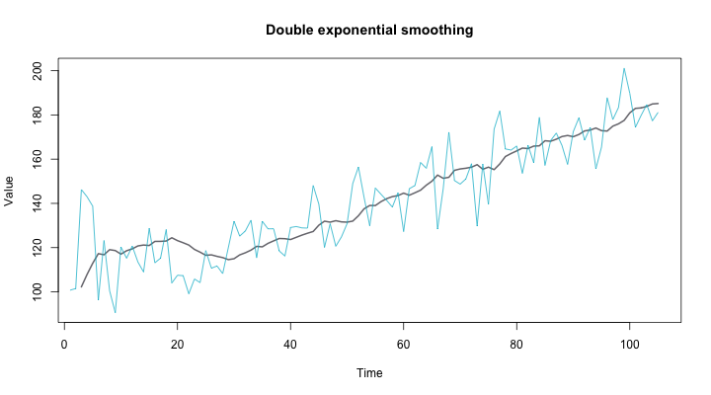
Holt-winters
Notice how the smoothed values are much better at following the original time series with double exponential smoothing. This means you’ll get much better forecasts.

Slide 61
Holt-winters
To forecast with this model, you have to make a slight adjustment. Because there’s another term for the slope, you’ll have to consider that in the forecast. Suppose you’re trying to forecast the value in m time steps in the future. The formula for the m-step-ahead forecast, Ft+m, is:
Ft+m=st+mbt
Notice how it’s essentially the formula for a line. What if your time series doesn’t have a linear trend, but rather some sort of seasonality? For this, you’ll need yet another EWMA.
Holt’s student, Peter Winters, extended his teacher’s model by introducing an additional term to factor in seasonality. Notice how there’s another variable L, which depends on the period of the seasonality and has to be known in advance.

Slide 62
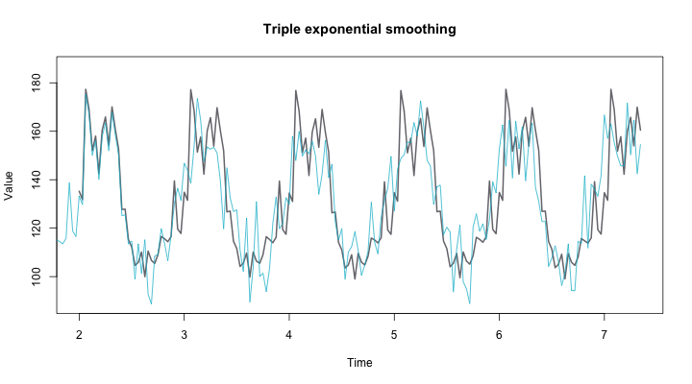
Holt-winters
The three aspects of the time series behavior—value, trend, and seasonality—are expressed as three types of exponential smoothing, so Holt-Winters is called triple exponential smoothing. The model predicts a current or future value by computing the combined effects of these three influences. The model requires several parameters: one for each smoothing (ɑ, β, γ), the length of a season, and the number of periods in a season.

Slide 63
Autocorrelation
Objective:
In this topic we learn about Autocorrelation which represents the degree of similarity between a given time series and a lagged version of itself over successive time intervals. Autocorrelation measures the relationship between a variable's current value and its past values.
Recap:
Revision of basic statistical approaches.

Slide 64
Autocorrelation
Autocorrelation
What Is Autocorrelation?
Autocorrelation is a mathematical representation of the degree of similarity between a given time series and a lagged version of itself over successive time intervals. It's conceptually similar to the correlation between two different time series, but autocorrelation uses the same time series twice: once in its original form and once lagged one or more time periods.
For example, if it's rainy today, the data suggests that it's more likely to rain tomorrow than if it's clear today. When it comes to investing, a stock might have a strong positive autocorrelation of returns, suggesting that if it's "up" today, it's more likely to be up tomorrow, too.
Naturally, autocorrelation can be a useful tool for traders to utilize; particularly for technical analysts.

Slide 65
Autocorrelation
KEY TAKEAWAYS
• Autocorrelation represents the degree of similarity between a given time series and a lagged version of itself over successive time intervals.
• Autocorrelation measures the relationship between a variable's current value and its past values.
• An autocorrelation of +1 represents a perfect positive correlation, while an autocorrelation of negative 1 represents a perfect negative correlation.
• Technical analysts can use autocorrelation to measure how much influence past prices for a security have on its future price.
Autocorrelation
Understanding Autocorrelation
Autocorrelation can also be referred to as lagged correlation or serial correlation, as it measures the relationship between a variable's current value and its past values.
As a very simple example, take a look at the five percentage values in the chart below. We are comparing them to the column on the right, which contains the same set of values, just moved up one row.

Slide 66
Autocorrelation
When calculating autocorrelation, the result can range from -1 to +1.
An autocorrelation of +1 represents a perfect positive correlation (an increase seen in one time series leads to a proportionate increase in the other time series).
On the other hand, an autocorrelation of -1 represents a perfect negative correlation (an increase seen in one time series results in a proportionate decrease in the other time series).
Autocorrelation measures linear relationships. Even if the autocorrelation is minuscule, there can still be a nonlinear relationship between a time series and a lagged version of itself.

Slide 67
Autocorrelation
Testing for Autocorrelation
The most common method of test autocorrelation is the Durbin-Watson test. Without getting too technical, the Durbin-Watson is a statistic that detects autocorrelation from a regression analysis.
The Durbin-Watson always produces a test number range from 0 to 4. Values closer to 0 indicate a greater degree of positive correlation, values closer to 4 indicate a greater degree of negative autocorrelation, while values closer to the middle suggest less autocorrelation.
So why is autocorrelation important in financial markets? Simple. Autocorrelation can be applied to thoroughly analyze historical price movements, which investors can then use to predict future price movements. Specifically, autocorrelation can be used to determine if a momentum trading strategy makes sense.

Slide 68
Autocorrelation
Autocorrelation in Technical Analysis
Autocorrelation can be useful for technical analysis, That's because technical analysis is most concerned with the trends of, and relationships between, security prices using charting techniques. This is in contrast with fundamental analysis, which focuses instead on a company's financial health or management.
Technical analysts can use autocorrelation to figure out how much of an impact past prices for a security have on its future price.
Autocorrelation can help determine if there is a momentum factor at play with a given stock. If a stock with a high positive autocorrelation posts two straight days of big gains, for example, it might be reasonable to expect the stock to rise over the next two days, as well.
Example of Autocorrelation
Let’s assume Rain is looking to determine if a stock's returns in their portfolio exhibit autocorrelation; that is, the stock's returns relate to its returns in previous trading sessions.
If the returns exhibit autocorrelation, Rain could characterize it as a momentum stock because past returns seem to influence future returns. Rain runs a regression with the prior trading session's return as the independent variable and the current return as the dependent variable. They find that returns one day prior have a positive autocorrelation of 0.8.
Since 0.8 is close to +1, past returns seem to be a very good positive predictor of future returns for this particular stock.
Therefore, Rain can adjust their portfolio to take advantage of the autocorrelation, or momentum, by continuing to hold their position or accumulating more shares.

Slide 69
ARIMA
Objective:
In this topic we learn about an autoregressive integrated moving average, or ARIMA, is a statistical analysis model that uses time series data to either better understand the data set or to predict future trends. A statistical model is autoregressive if it predicts future values based on past values.
Recap:
Revision of basic statistical approaches.

Slide 70
ARIMA
What Is an Autoregressive Integrated Moving Average (ARIMA)?
An autoregressive integrated moving average, or ARIMA, is a statistical analysis model that uses time series data to either better understand the data set or to predict future trends.
A statistical model is autoregressive if it predicts future values based on past values. For example, an ARIMA model might seek to predict a stock's future prices based on its past performance or forecast a company's earnings based on past periods.
KEY TAKEAWAYS
• Autoregressive integrated moving average (ARIMA) models predict future values based on past values.
• ARIMA makes use of lagged moving averages to smooth time series data.
• They are widely used in technical analysis to forecast future security prices.
• Autoregressive models implicitly assume that the future will resemble the past.
• Therefore, they can prove inaccurate under certain market conditions, such as financial crises or periods of rapid technological change.

Slide 71
ARIMA
Understanding Autoregressive Integrated Moving Average (ARIMA)
An autoregressive integrated moving average model is a form of regression analysis that gauges the strength of one dependent variable relative to other changing variables. The model's goal is to predict future securities or financial market moves by examining the differences between values in the series instead of through actual values.
An ARIMA model can be understood by outlining each of its components as follows:
• Autoregression (AR): refers to a model that shows a changing variable that regresses on its own lagged, or prior, values.
• Integrated (I): represents the differencing of raw observations to allow for the time series to become stationary (i.e., data values are replaced by the difference between the data values and the previous values).
• Moving average (MA): incorporates the dependency between an observation and a residual error from a moving average model applied to lagged observations.

Slide 72
ARIMA
ARIMA Parameters
Each component in ARIMA functions as a parameter with a standard notation. For ARIMA models, a standard notation would be ARIMA with p, d, and q, where integer values substitute for the parameters to indicate the type of ARIMA model used. The parameters can be defined as:
• p: the number of lag observations in the model; also known as the lag order.
• d: the number of times that the raw observations are differenced; also known as the degree of differencing.
• q: the size of the moving average window; also known as the order of the moving average.
In a linear regression model, for example, the number and type of terms are included. A 0 value, which can be used as a parameter, would mean that particular component should not be used in the model. This way, the ARIMA model can be constructed to perform the function of an ARMA model, or even simple AR, I, or MA models.

Slide 73
ARIMA
Because ARIMA models are complicated and work best on very large data sets, computer algorithms and machine learning techniques are used to compute them.
Autoregressive Integrated Moving Average (ARIMA) and Stationarity
In an autoregressive integrated moving average model, the data are differenced in order to make it stationary. A model that shows stationarity is one that shows there is constancy to the data over time. Most economic and market data show trends, so the purpose of differencing is to remove any trends or seasonal structures.
Seasonality, or when data show regular and predictable patterns that repeat over a calendar year, could negatively affect the regression model. If a trend appears and stationarity is not evident, many of the computations throughout the process cannot be made with great efficacy.
A one-time shock will affect subsequent values of an ARIMA model infinitely into the future. Therefore, the legacy of the financial crisis lives on in today’s autoregressive models.

Slide 74
ARIMA
Special Considerations
ARIMA models are based on the assumption that past values have some residual effect on current or future values. For example, an investor using an ARIMA model to forecast stock prices would assume that new buyers and sellers of that stock are influenced by recent market transactions when deciding how much to offer or accept for the security.
Although this assumption will hold under many circumstances, this is not always the case. For example, in the years prior to the 2008 Financial Crisis, most investors were not aware of the risks posed by the large portfolios of mortgage-backed securities (MBS) held by many financial firms.
During those times, an investor using an autoregressive model to predict the performance of U.S. financial stocks would have had good reason to predict an ongoing trend of stable or rising stock prices in that sector. However, once it became public knowledge that many financial institutions were at risk of imminent collapse, investors suddenly became less concerned with these stocks' recent prices and far more concerned with their underlying risk exposure. Therefore, the market rapidly revalued financial stocks to a much lower level, a move that would have utterly confounded an autoregressive model.

Slide 75
Examples: Applications of Time Series in financial markets
Objective:
In this topic we learn about some application areas of time series in financial market.
Recap:
Revision of basic statistical approaches.

Slide 76
Examples: Applications of Time Series in financial markets
APPLICATION OF TIME SERIES ANALYSIS IN FINANCIAL ECONOMICS
In this blog, I will explain to you a few applications of Time Series Analysis in financial economics. But, before that let us understand what exactly a time series analysis and Data Analysis
Time Series Analysis
A time series is actually a sequence of data points recorded at regular intervals of time (yearly, quarterly, monthly, daily). Time series includes two types:
1. Univariate — involves a single variable
2. Multivariate — involves two or more variables
Let me present you with a list of examples of time series:
Monthly or daily precipitation of a region
Daily stock prices (opening, closing) over a period of years/days.
Monthly bike sales over a period of 3 years
Annual unemployment rate over a period of 10 years

Slide 77
Examples: Applications of Time Series in financial markets
Forecasting Time Series Data
The main objective of a Time Series Analysis is to develop a suitable model to describe the pattern or trend in data with more accuracy. However, forecasting a time series data predicts future outcomes based on the immediate past. Forecasting can be done for closing/opening the rate of stock on a daily basis, quarterly revenues of a company, etc., There are various models available in the literature to forecast the time series data. Some of them are:
• Autoregressive Integration Moving Average (ARIMA)
• Simple Moving Average (SMA)
• Exponential Smoothing (SES)
• Neural Network (NN)
• Linear Regression Models
• Logistic Regression
• Support Vector Machine
• Naive Bayes
• Hidden Markov
• VAR
• Gaussian Processes

Slide 78
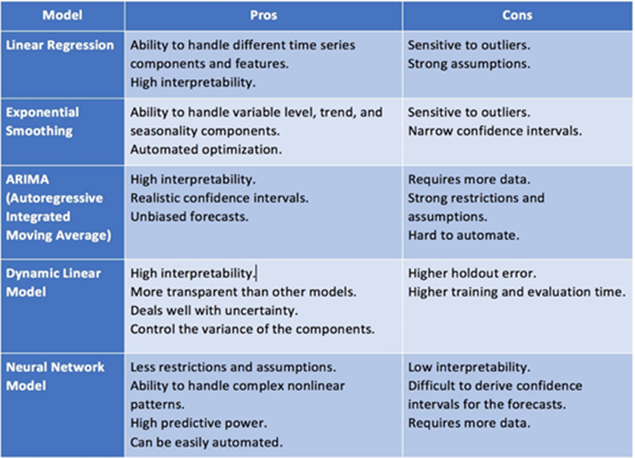
Examples: Applications of Time Series in financial markets
Well, many complex models or techniques may be useful in certain cases to forecast time series data. They are:
· Neural Networks Autoregression (NNAR)
· RNN (Recurrent Neural Network)
· Bayesian-based models
· Generalized Autoregressive Conditional Heteroskedasticity (GARCH)

Slide 79
Examples: Applications of Time Series in financial markets
Time Series Analysis
The performance of the time series models can be interpreted based on its error terms such as AIC, BIC, Mean Squared Error, etc. and it can be emphasized for forecasting.
The principle interest for every time series analysis is to split the original series into independent components. The decomposition of time series is much easy to forecast the individual regular patterns produced than from the actual series. Typically, time series are further split into three main components:
· Trend
· Seasonality
· Cycle
Applications of Time Series Forecasting:
Time series models usually used to forecast the stock’s performance, interest rate, weather, etc. In this post, we will look at a few situations where time series can be useful to forecast future outcomes.

Slide 80
Daily Quiz
How the IQR (Interquartile Range) is used in Time Series Forecasting?
What are some common Data Preparation Operations you would use for Time Series Data?
What are somWhat is the Sliding Window method for Time Series Forecasting?
What are examples of Time-Series Data which can be Mined?
Why does a Time Series have to be Stationary?
What is an ARIMA model? Why might ARIMA models be considered particularly useful for financial time series?
Describe the steps that Box and Jenkins (1970) suggested should be involved in constructing an ARMA model.
‘Given that the objective of any econometric modeling exercise is to find the model that most closely “fits” the data, then adding more lags to an ARMA model will almost invariably lead to a better fit. Therefore, a large model is best because it will fit the data more closely.’ Comment on the validity (or otherwise) of this statement.

Slide 81
Weekly/monthly/Unit Wise Assignment.
Assignment
What is meant by the term stationary, as applied to a time series model? Explain how the notation I (0) and I (1) is related to the concept of stationarity. Give one example of a stationary model and one of a non-stationary model.
What are unit root tests and why are they important?
What stylized features of financial data cannot be explained using linear models? Which of these features could be modeled using an ARCH/GARCH process?
How do we use machine leaning models for univariate time series data? (other than AR and MA terms)?
Explain Box-Jenkins in detail?
What do you understand by autocorrelation? How is it useful?
Explain the concept of smoothing time series in detail?
List all applications of time series in financial markets?
Can Non-Sequential Deep Learning Models outperform Sequential Models in Time-Series Forecasting?
Compare some Forecasting Techniques for Stationary and Non-stationary Time-Series?

Slide 82
Faculty Video Links, You tube & NPTEL Video Links and Online Courses Details
You Tube video
(1) Predictive Analytics Tutorial | Linear Regression in Python | Logistic Regression | Great Learning - YouTube
(2) Multiple Regression Analysis: Hypothesis Tests - YouTube
(3) Mod-06 Lec-28 Goodness of Fit - YouTube

Slide 83
MCQ unit wise/weekly
1) Smoothing parameter close to one gives more weight or influence to recent observations over the forecast.
A) TRUE
B) FALSE
2) Sum of weights in exponential smoothing is _____.
A) <1
B) 1
C) >1
D) None of the above
3) The last period’s forecast was 70 and demand was 60. What is the simple exponential smoothing forecast with alpha of 0.4 for the next period.
A) 63.8
B) 65
C) 62
D) 66

Slide 84
MCQ unit wise/weekly
4) What does autocovariance measure?
A) Linear dependence between multiple points on the different series observed at different times
B)Quadratic dependence between two points on the same series observed at different times
C) Linear dependence between two points on different series observed at same time
D) Linear dependence between two points on the same series observed at different times
5) Which of the following is not a necessary condition for weakly stationary time series?
A) Mean is constant and does not depend on time
B) Autocovariance function depends on s and t only through their difference |s-t| (where t and s are moments in time)
C) The time series under considerations is a finite variance process
D) Time series is Gaussian

Slide 85
MCQ unit wise/weekly
12) Which of the following is not a technique used in smoothing time series?
A) Nearest Neighbour Regression
B) Locally weighted scatter plot smoothing
C) Tree based models like (CART)
D) Smoothing Splines
13) If the demand is 100 during October 2016, 200 in November 2016, 300 in December 2016, 400 in January 2017. What is the 3-month simple moving average for February 2017?
A) 300
B) 350
C) 400
D) Need more information
15) Suppose, you are a data scientist at Analytics Vidhya. And you observed the views on the articles increases during the month of Jan-Mar. Whereas the views during Nov-Dec decreases.
Does the above statement represent seasonality?
A) TRUE
B) FALSE
C) Can’t Say

Slide 86
Glossary Questions
1) Which of the following is an example of time series problem?
1. Estimating number of hotel rooms booking in next 6 months.
2. Estimating the total sales in next 3 years of an insurance company.
3. Estimating the number of calls for the next one week.
A) Only 3
B) 1 and 2
C) 2 and 3
D) 1 and 3
2) Which of the following is not an example of a time series model?
A) Naive approach
B) Exponential smoothing
C) Moving Average
D)None of the above

Slide 87
Glossary Questions
3) Which of the following can’t be a component for a time series plot?
A) Seasonality
B) Trend
C) Cyclical
D) Noise
None of the above
4) Which of the following is relatively easier to estimate in time series modeling?
A) Seasonality
B) Cyclical
C) No difference between Seasonality and Cyclical
5) Adjacent observations in time series data (excluding white noise) are independent and identically distributed (IID).
A) TRUE
B) FALSE

Slide 88
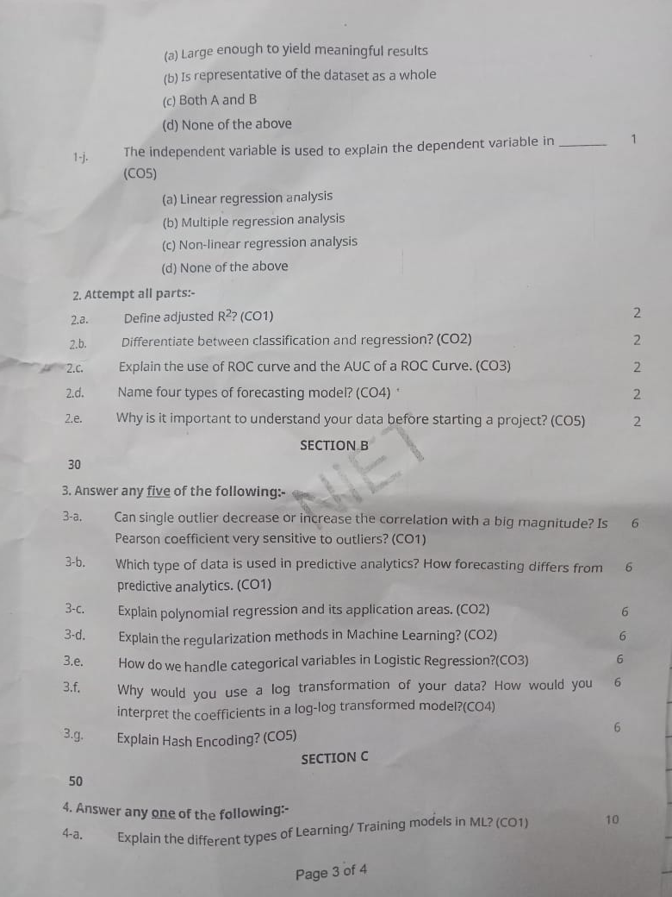
Semester Paper

Slide 89
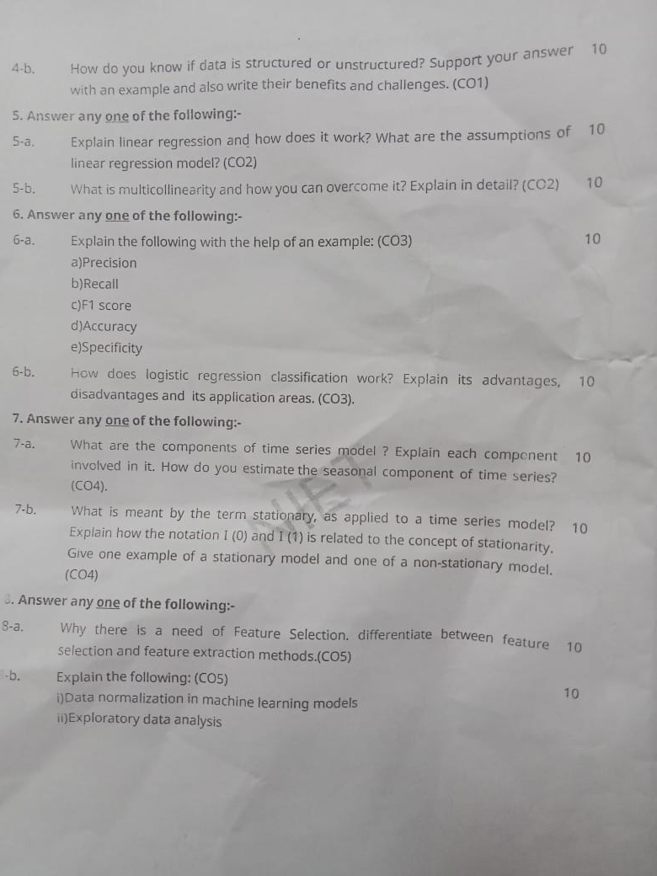
Semester Paper

Slide 90
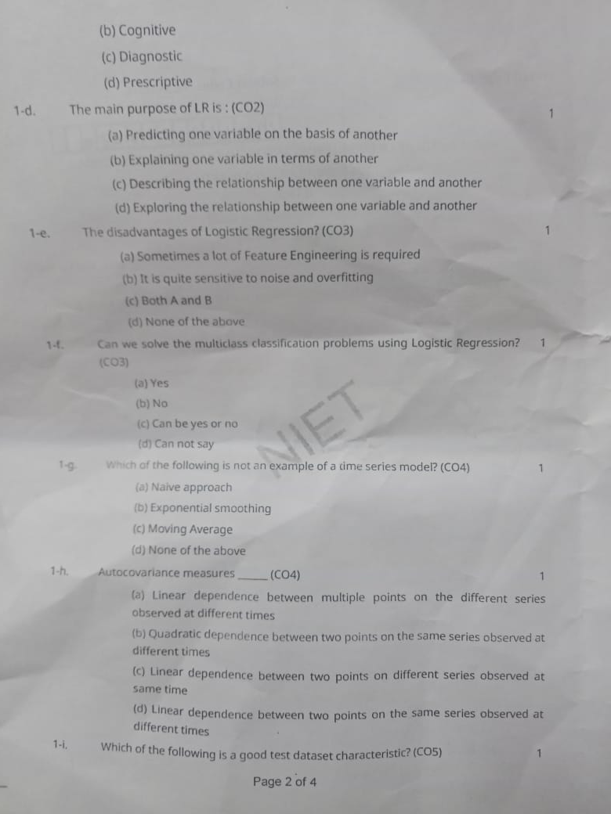
Semester Paper

Slide 91
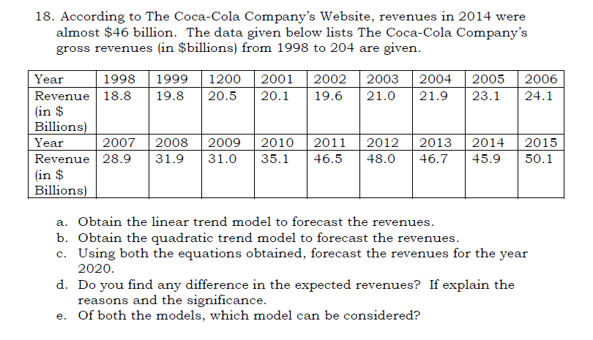
Expected Questions for University Exam

Slide 92
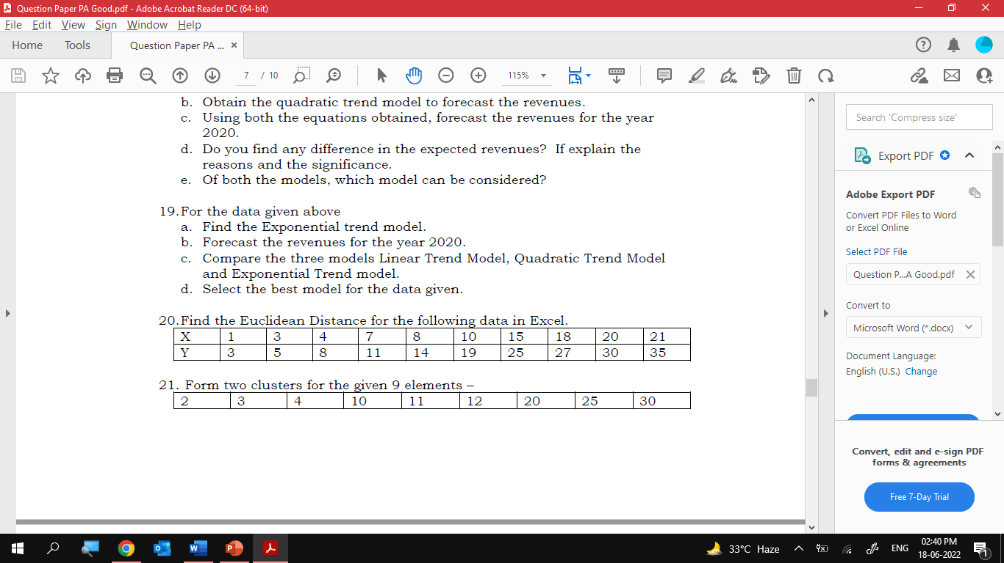
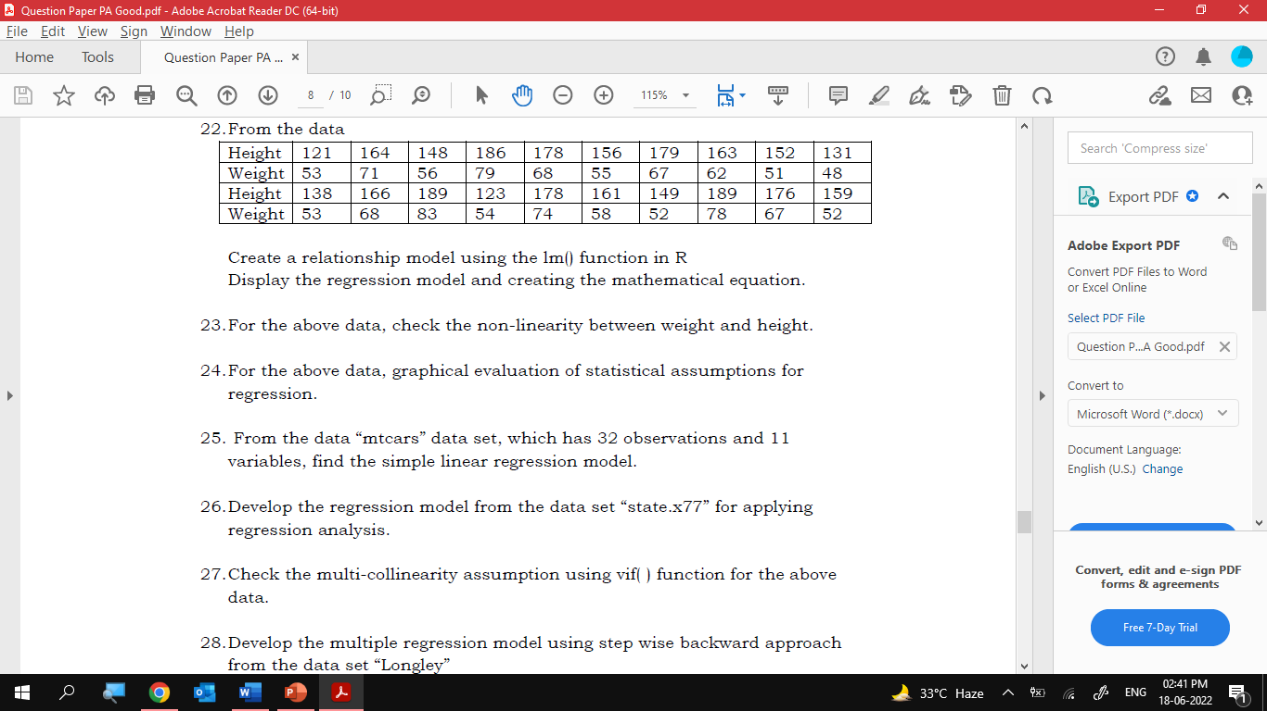
Expected Questions for University Exam

Slide 93
References
Text books
1. Dean Abbott ,“Applied Predictive Analytics Principles and Techniques for the Professional DataAnalyst” , Wiley.
2. “Fundamentals of Machine Learning for Predictive Data Analytics” By John D. Kelleher, Brian Mac Namee and Aoife D'Arcy
3. Predictive & Advanced Analytics (IBM ICE Publication)
Reference Books
1. “An Introduction to Statistical Learning: with Applications in R” by James, Witten, Hastie and Tibshirani, Springer, 1st. Edition, 2013.
2.“R for Everyone: Advanced Analytics and Graphics” by Lander, J., Addison-Wesley Data & Analytics Series, 1 edition, 2013.
3.Sandeep Rakshit, R for Beginners, McGraw Hill (2017).

Slide 94
Recap
This unit provide us fundamentals domain of Data Science and its latest trends in industry.
In this unit we are also benefitted with the knowledge of different types of data and very important is the implementation of machine learning and also through the concept model building which is used in industry prospects.
The main advantage of ARIMA forecasting is that it requires data on the time series in question only. First, this feature is advantageous if one is forecasting a large number of time series.
Second, this avoids a problem that occurs sometimes with multivariate

Slide 95
CONTENTS
Thank You

